Slide 1

Dependency Injection
SoftUni Team
Technical Trainers
Software University
http://softuni.bg

Slide 2
Table of Contents
What is dependency injection?
Microsoft Dependency Injection
Custom DI Framework

Slide 3
Have a Question?
sli.do
#csharp-advanced

Slide 4
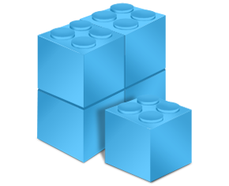
Dependency Injection Overview
A design pattern in programming

Slide 5
What is a Dependency ?
Another object that your class needs
Other Examples (Framework, Database, File System, Providers)
Classes dependent on each other are called coupled
Dependencies are bad because they decrease reuse
public class Customer
{
private CustomerService customerService;
public Customer()
{
this.customerService = new CustomerService();
}
}

Slide 6
Dependency Injection (1)
Dependency Injection is a popular design pattern
Inversion of Control (IoC)
Dependencies are pushed in the class from the outside
The class does not instantiate it's dependencies
public class Customer
{
private customerService;
public Customer(CustomerService customerService)
{
this.customerService = customerService;
}
}

Slide 7

Dependency Injection (2)
How it should be
Classes should declare what they need
Constructors should require dependencies
Dependencies should be abstractions
How to do it
Dependency Injection (usually called DI)
The Hollywood principle "Don't call us, we'll call you!"

Slide 8



Types of Dependency Injection
Constructor
injection
Property
injection
Parameter
injection

Slide 9
Constructor Injection – Pros and Cons
Pros
Class’ requirements are self-documenting
We don’t have to worry about state validation
Cons
Too many parameters
Sometimes, the functionality doesn’t need all of the dependencies

Slide 10
Constructor Injection - Example
class Copy
{
private IReader reader;
private IWriter writer;
public Copy(IReader reader, IWriter writer)
{
this.reader = reader;
this.writer = writer;
}
// Read/Write data through the reader/writer
}
var copy = new Copy(new ConsoleReader(),
new FileWriter("out.txt"));

Slide 11
Property Injection – Pros and Cons
Pros
Functionality can be changed at any time
That makes the code very flexible
Cons
State can be invalid
Less intuitive to use

Slide 12
Property Injection - Example
class Copy
{
public IReader Reader { get; set; }
public IWriter Writer { get; set; }
public void CopyAllChars(reader, writer)
{
// Read/Write data through the reader/writer
}
}
Copy copy = new Copy();
copy.Reader = new ConsoleReader();
copy.Writer = new FileWriter("output.txt");
copy.CopyAllChars();

Slide 13
Parameter Injection – Pros and Cons
Pros
Changes are only localized to the method
Cons
Too many parameters
Breaks the method signature

Slide 14
Parameter Injection - Example
class Copy
{
public CopyAllChars(IReader reader, IWriter writer)
{
// Read/Write data through the Reader/Writer
}
}
Copy copy = new Copy();
var reader = new ConsoleReader();
var writer = new FileWriter("output.txt");
copy.CopyAllChars(reader, writer);

Slide 15
DIP Violations
Classic DIP Violations:
Using the new keyword
Using static methods / properties
How to fix code, that violates the DIP:
Extract interfaces + use constructor injection
Set up an Inversion of Control (IoC) container
Notes:
Classic violations of DIP
Using of the new keyword
Using static methods / properties
How to fix broken DIP?
Extract interfaces + use constructor injection
Inversion of Control (IoC) container

Slide 16

Framework Overview

Slide 17


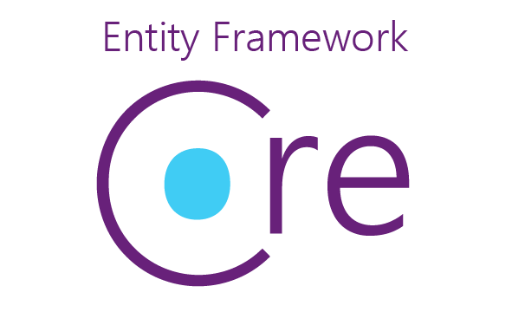
What is framework?
A framework is a reusable, “semi-complete” application that can be specialized to produce custom applications. “Johnson and Foote 1988”

Slide 18
Framework goals
Reuse: code, design, analysis and documentation
Simplify software development
Reduce code writing
Allow inexperienced programmers to develop good software
Extract the knowledge of experienced programmers

Slide 19

Microsoft Dependency Injection

Slide 20
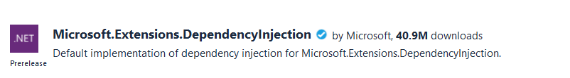
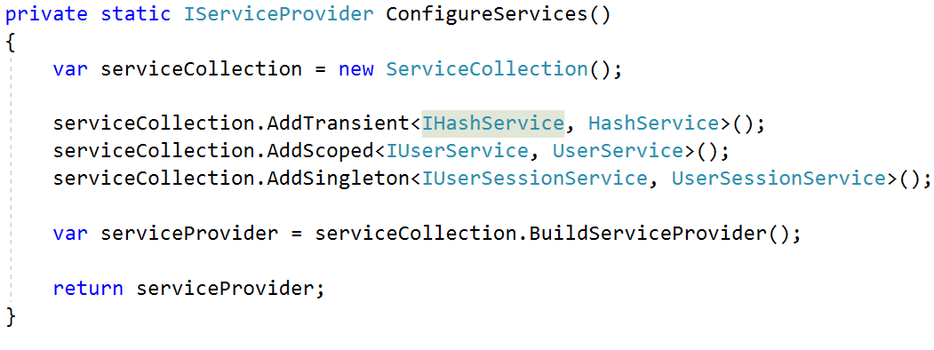
Microsoft Dependency Injection
Install Microsoft.Extensions.DependecyInjection
Define IoC Container

Slide 21
Register Services
AddTransient<Interface, Implementation>()
New instance is provided to every controller and every service
AddScoped<Interface, Implementation>()
Objects are the same within a request, but different across different requests
AddSingelton<Interface, Implementation>()
Only one instance is provided

Slide 22

Custom DI Framework
Live Demo

Slide 23

Summary
Dependency Injection provides better code quality
Testable
Maintainable
Reusable
Readable
Implementing Custom Framework
Notes:
23

Slide 24
Questions?
Notes:
24

Slide 25







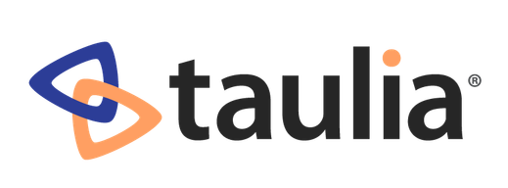




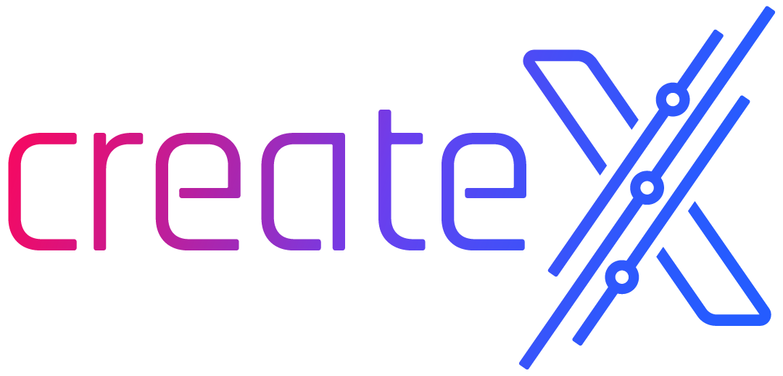
SoftUni Diamond Partners

Slide 26

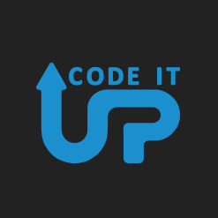
Educational Partners

Slide 27

License
This course (slides, examples, demos, exercises, homework, documents, videos and other assets) is copyrighted content
Unauthorized copy, reproduction or use is illegal
© SoftUni – https://about.softuni.bg/
© Software University – https://softuni.bg
Notes:
27

Slide 28
Trainings @ Software University (SoftUni)
Software University – High-Quality Education, Profession and Job for Software Developers
softuni.bg, about.softuni.bg
Software University Foundation
softuni.foundation
Software University @ Facebook
facebook.com/SoftwareUniversity
Software University Forums
forum.softuni.bg
Notes:
28

